Slide 1


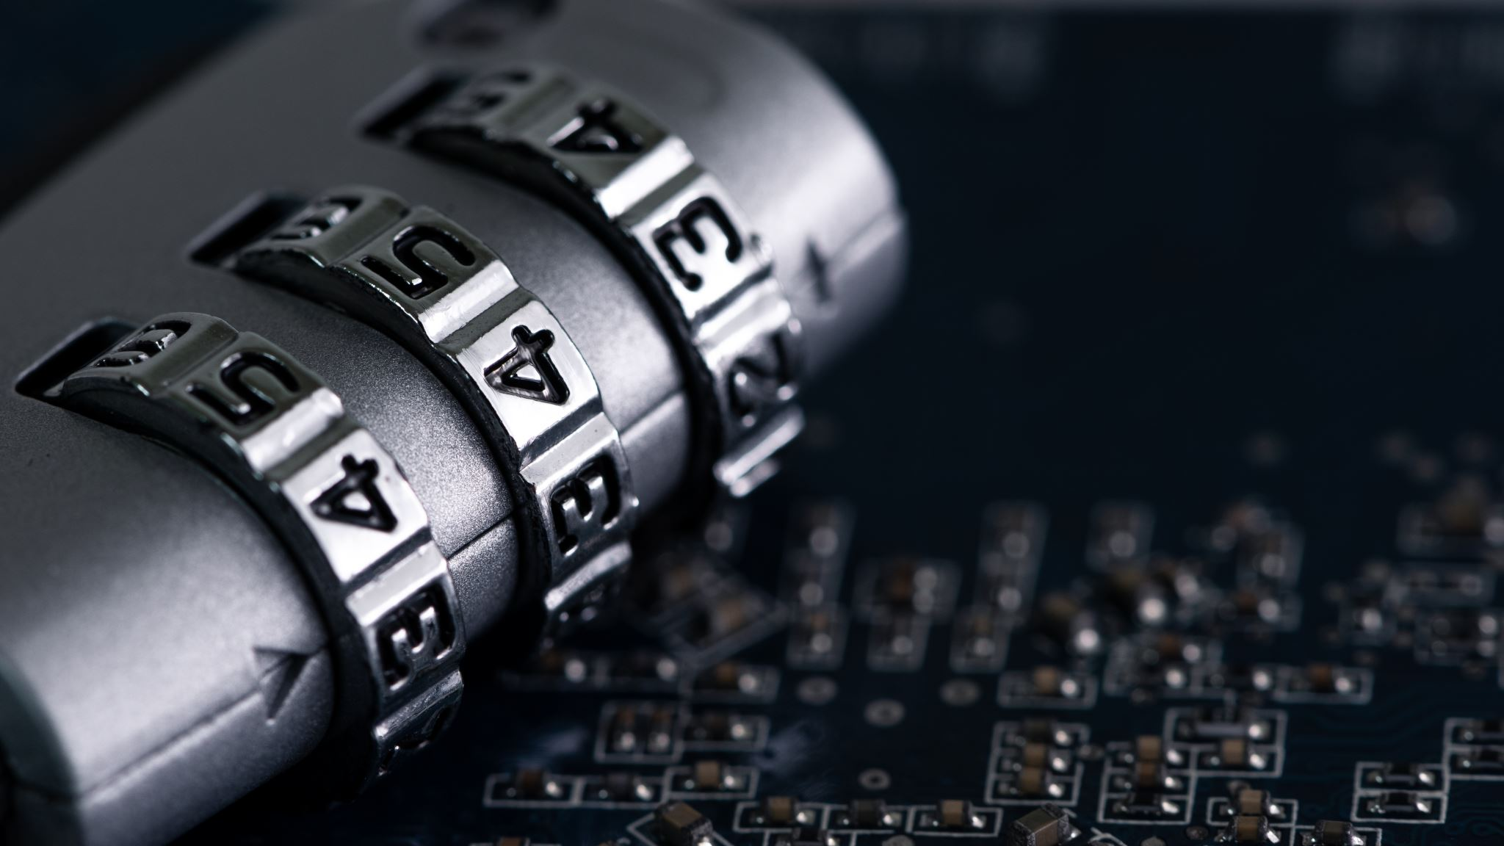

Smart Safe
Critical DESIGN REVIEW
GROUP 21
Notes:
Speaker: Eric

Slide 2
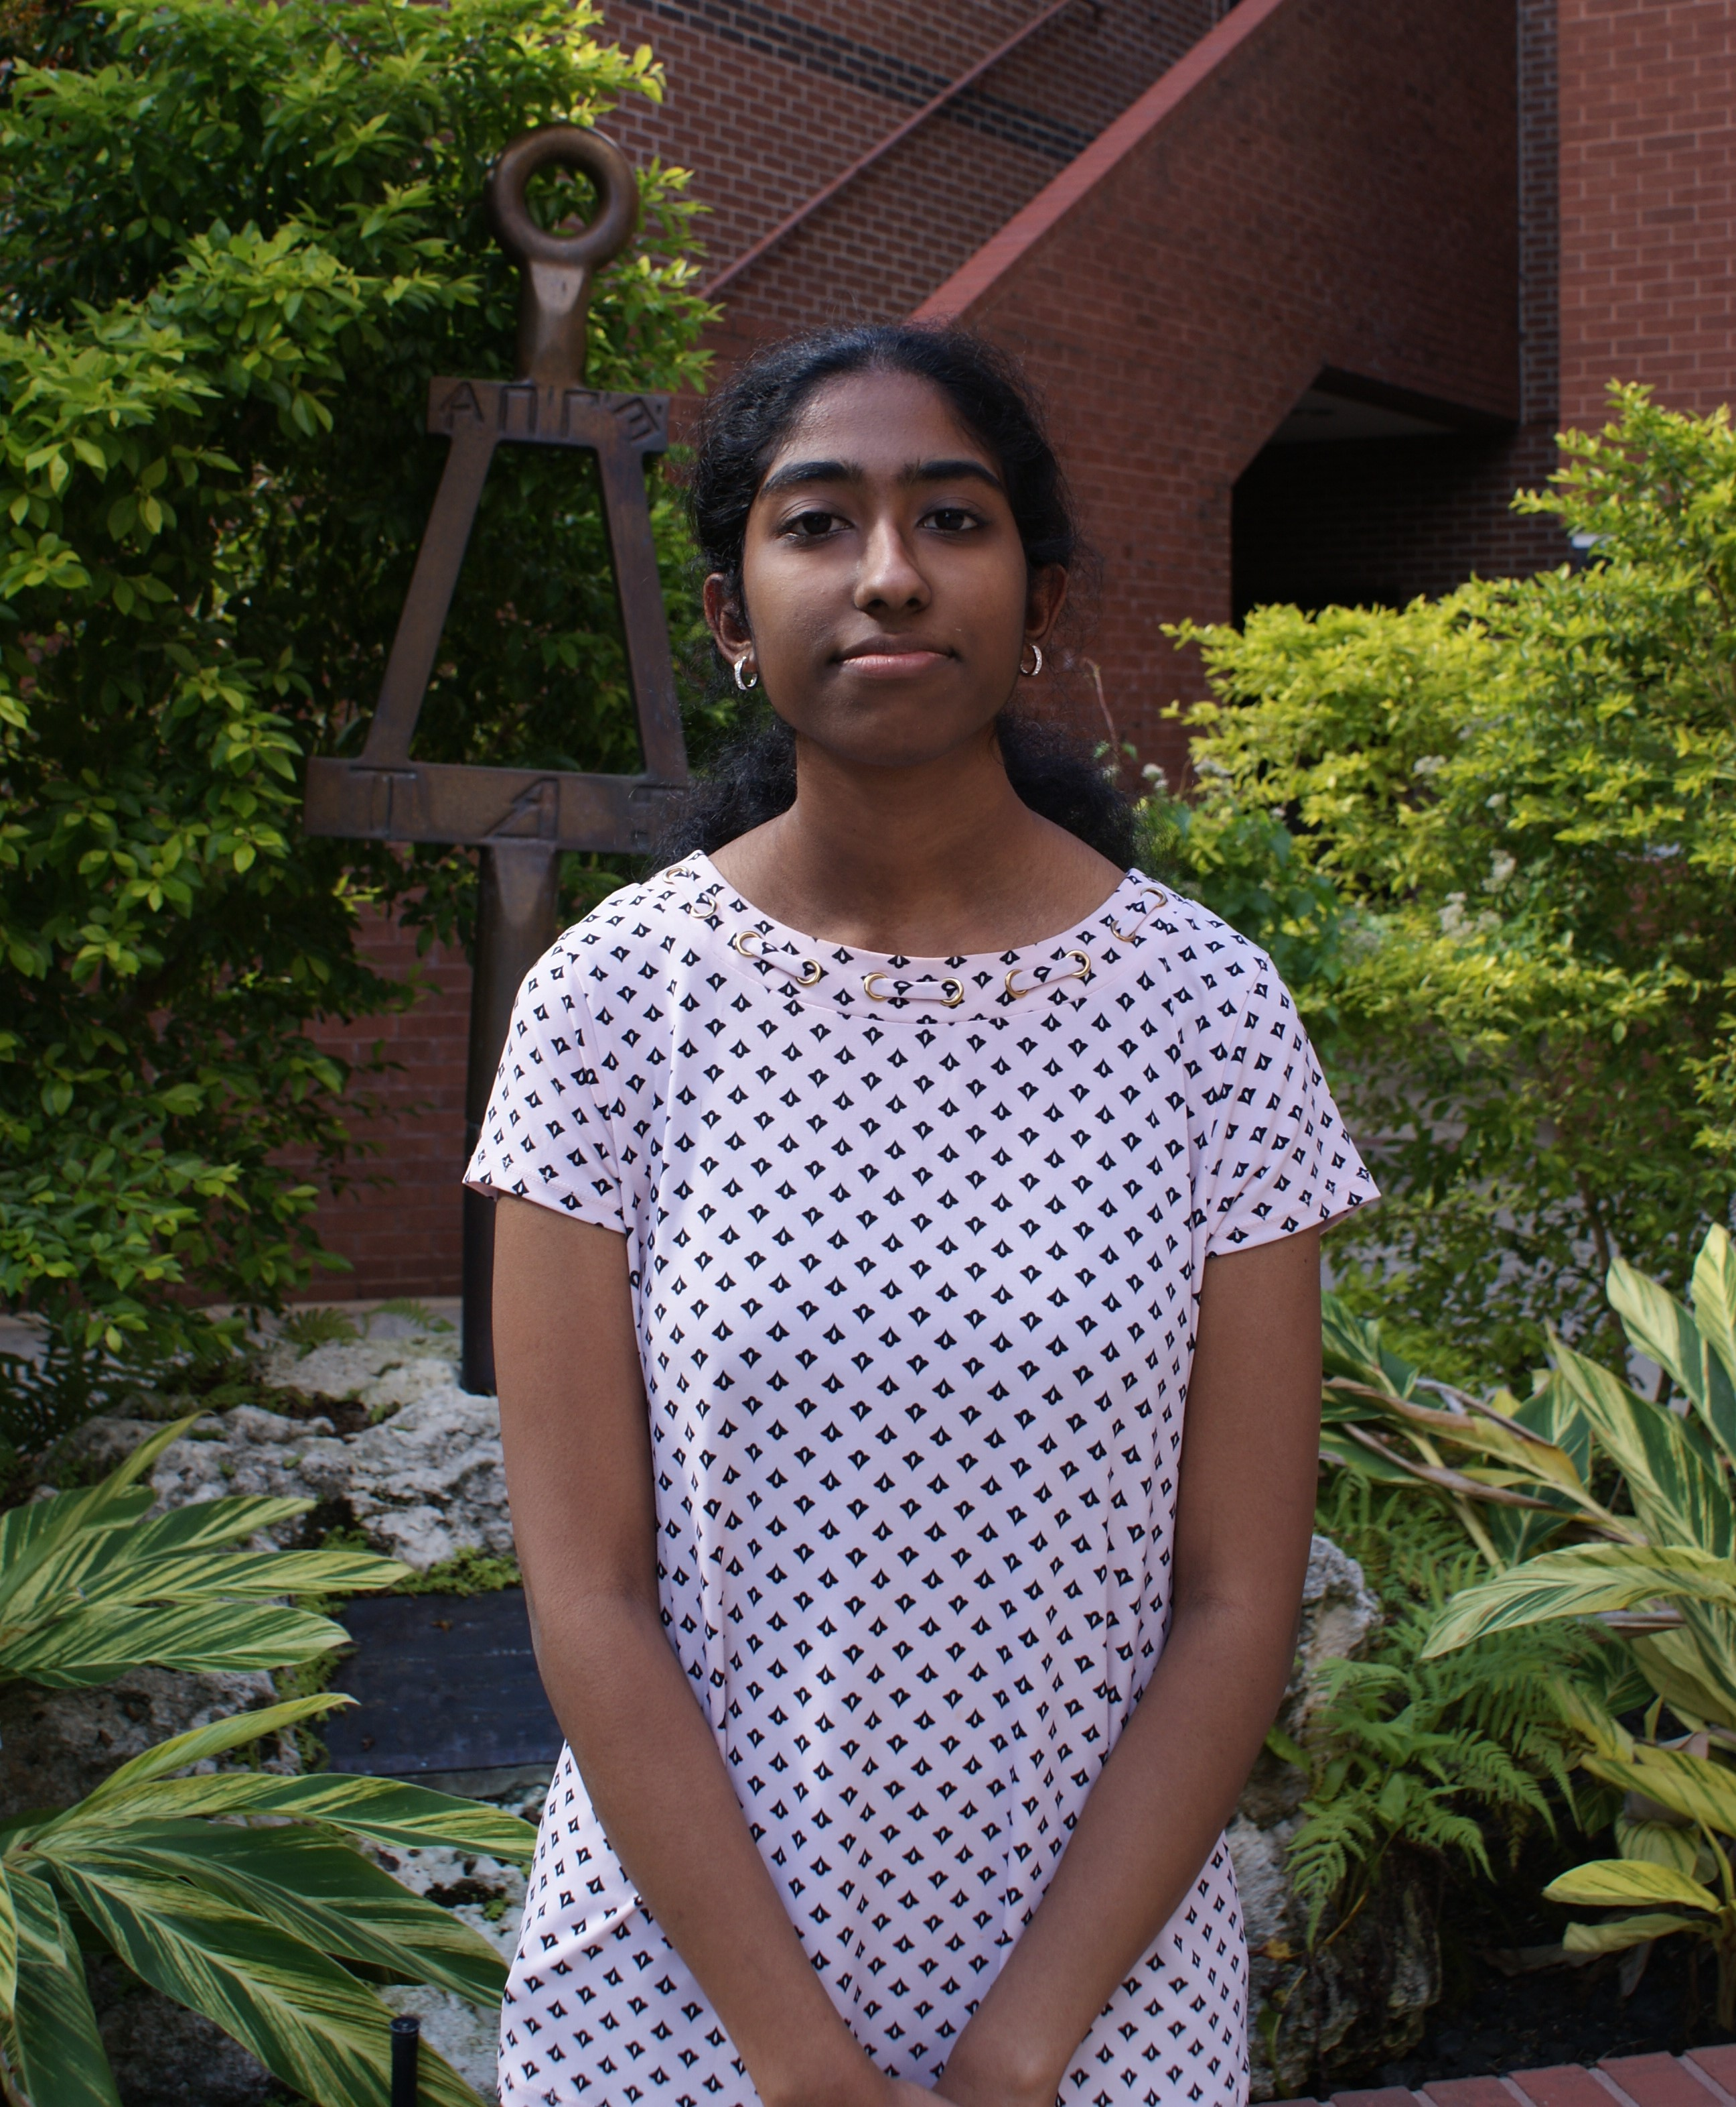


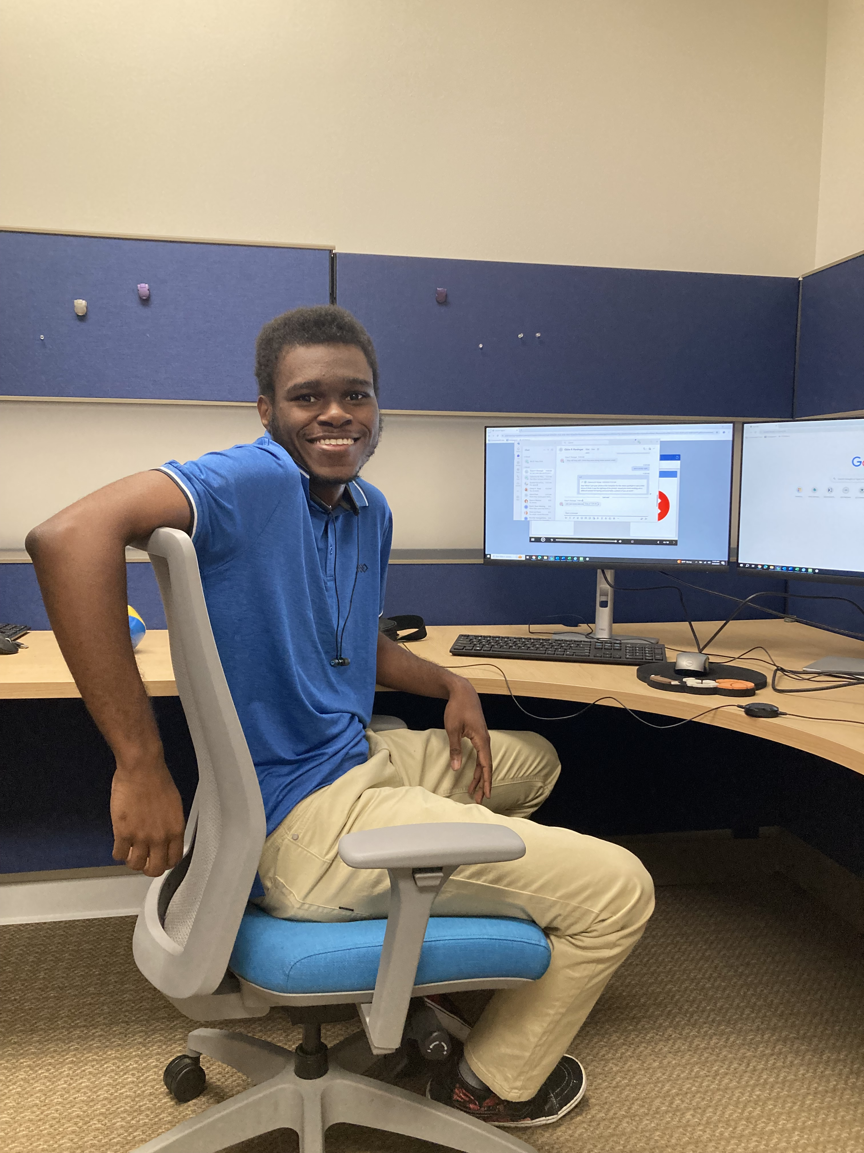
Meet the Team
Lakshmi (CpE)
Eric Terry
Electrical Engineering
Nick Brandenburg
Computer Engineering
Alexis Mui
Electrical Engineering
Lakshmi Katravulapalli
Computer Engineering
Notes:
Speaker: Everyone

Slide 3
Motivation and background
Ensuring the security of personal belongings is essential in today’s world
A reliable, secure, and portable storage for valuables
Real-time alerts for unauthorized access attempts or tampering
Create keyless, instant access
Provide awareness of its security status
Customize additional access levels and monitor usage remotely through email notifications
Alexis (EE)
Notes:
Speaker: Alexis

Slide 4
Basic Goals & Objectives
Basic Goals:
Unlock with correct passcode and remained locked with an incorrect passcode
Unlock with a registered fingerprint and remained locked with an unregistered fingerprint
Display readable user prompts during the safe’s operation
Send email notifications to inform the user when the safe is being accessed
Alexis (EE)
Notes:
Add to paper: registering email, door sensor, motion sensor time limit

Slide 5
Advanced goals & Objectives
Advanced Goals:
Register email to receive notifications on a web interface
Incorporate a battery backup system
Implement motion sensor and notify user
"Lockdown Mode" if three incorrect passcode attempts are made
Stretch Goals:
Tamper detection
Temperature/humidity sensor
User will receive an email in case they forget to close the safe door
Alexis (EE)
Notes:
Objectives to achieve goals
"objective" is a specific, measurable action or step you take to reach that goal, usually with a shorter timeframe and more defined deliverables

Slide 6
Engineering Requirements & Specifications
Specifications
*Fingerprint access accuracy | Unlocks safe 90% of the time (unless it’s an unregistered fingerprint)
Motion Sensor distance | Reads an input from >= 6 inches
Status LED accuracy | Is correct 90% of the time
*Email notification duration | Received in under 1 minute 95% of the time
*Lockdown Mode activation | Activates after 4 passcode attempts
Self-Lock Time Limit | Locks after 30 seconds
Safe Size | 18” x 10” x 10”
Nick (CpE)
*These will be our 3 demonstratable specifications
Notes:
Speaker: Eric/Nick (we need to change the paper table to 2 minutes –typo)

Slide 7
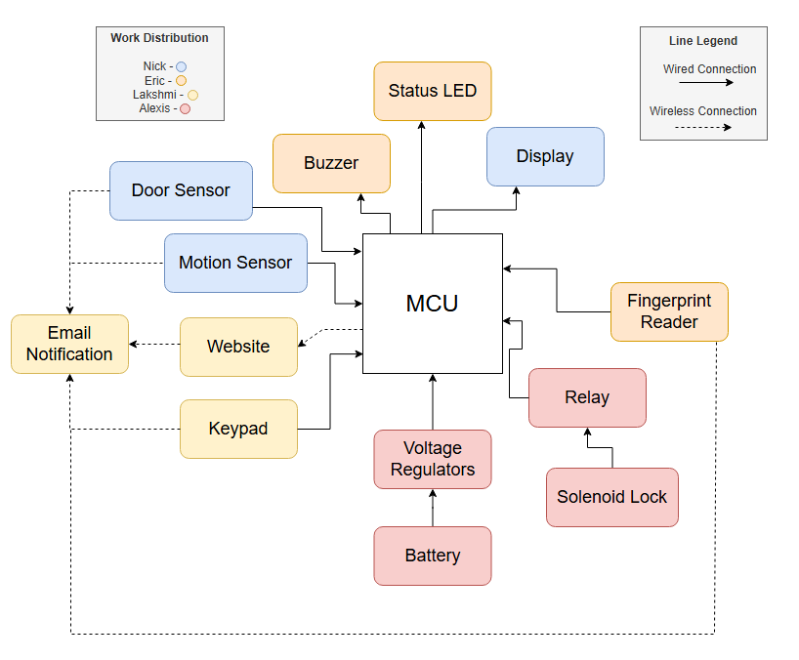
Hardware Block Diagram
Eric(EE)
Notes:
Speaker: Eric

Slide 8
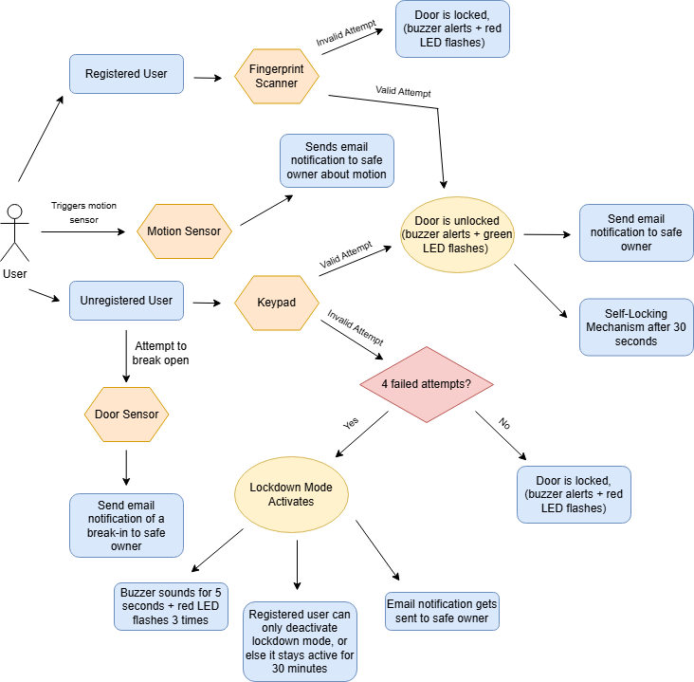
Software BLOCK Diagram/
Flowchart
Nick (CpE)
Notes:
Speaker: Lakshmi
(add motion sensor and register email to this diagram)
(maybe door sensor)
(registered user means they enrolled their fingperint, unregistered means their an outsider and cant use the fingerprint)
.

Slide 9
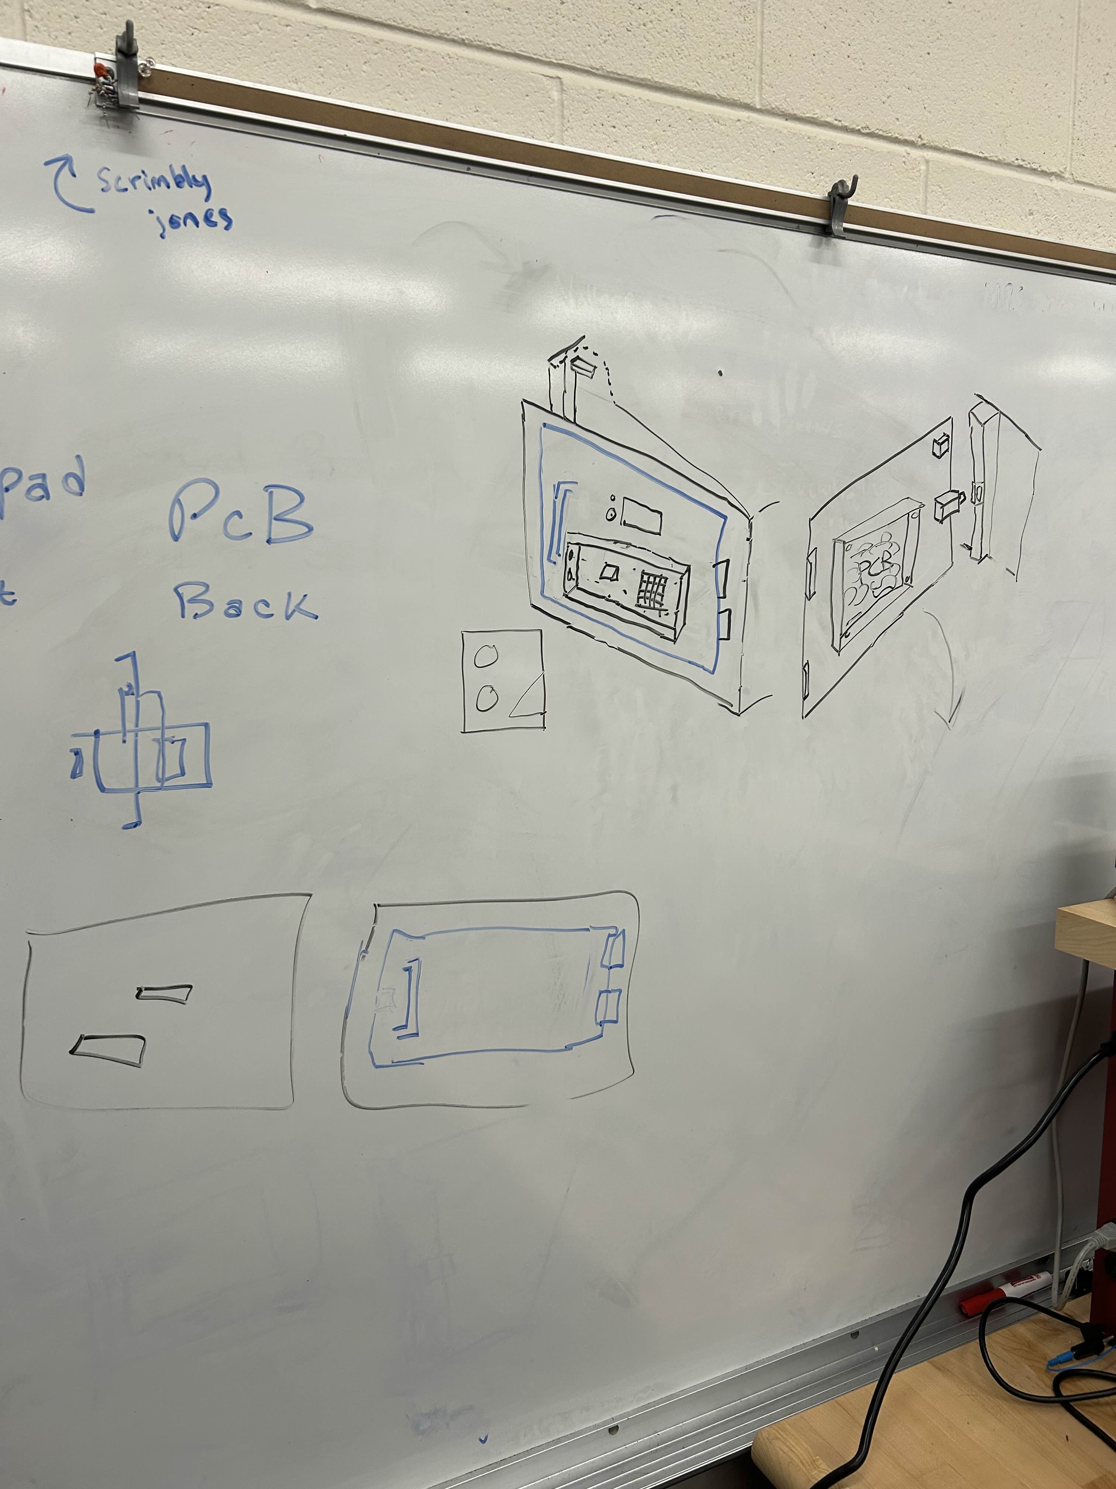
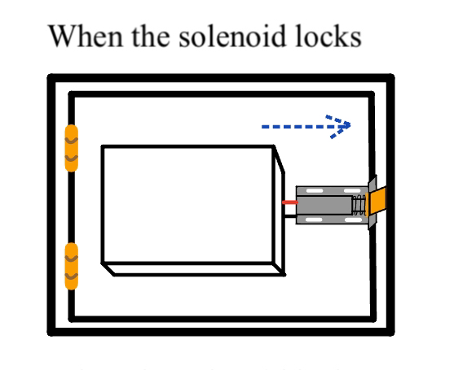
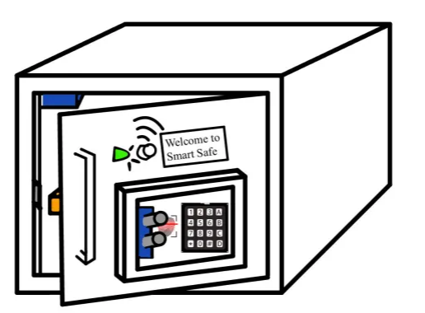
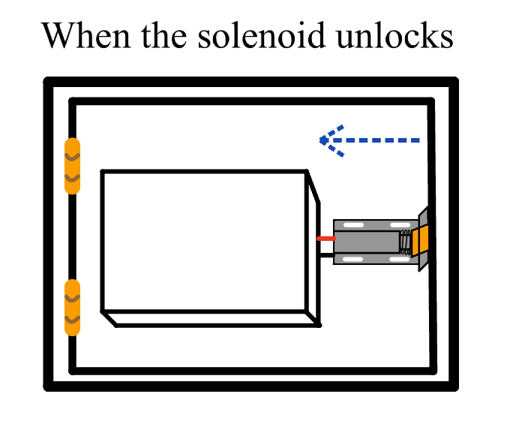
Safe Illustration/Sketch
Nick (CpE)
Notes:
Nick

Slide 10
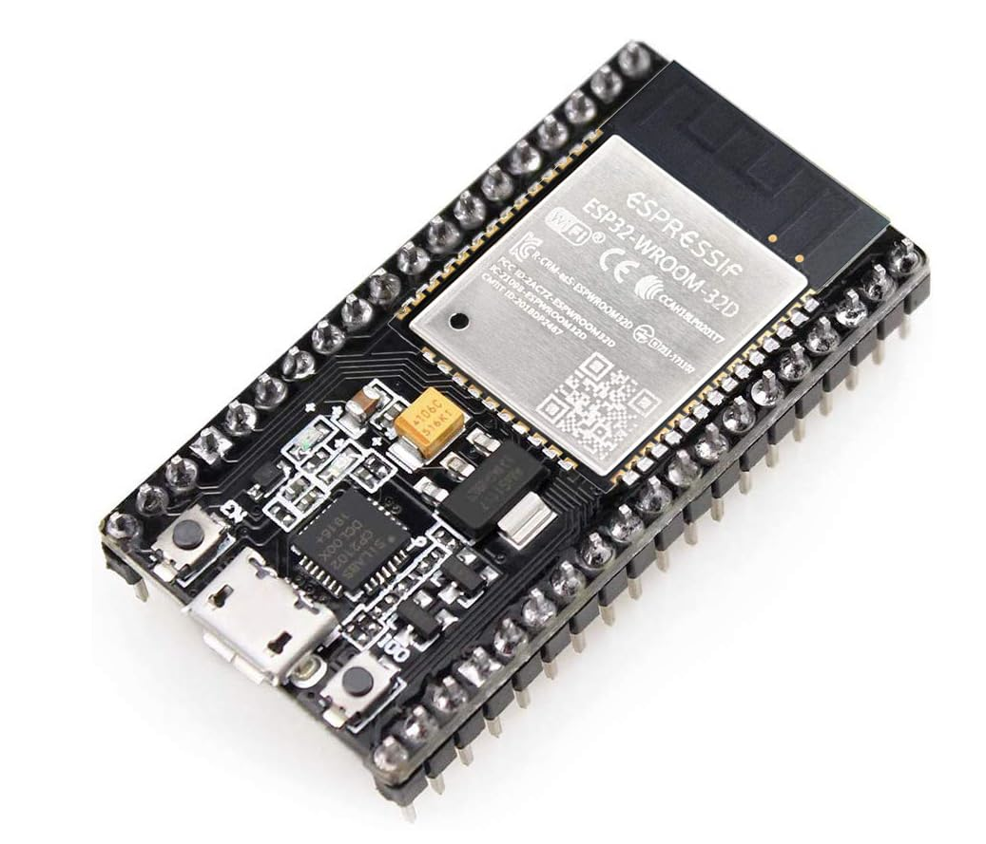
Microcontroller/Microprocessor selection
Product | Memory | Processor Speed | GPIO Pins | Operating Voltage | Cost
Arduino Mega 2560 Rev 3 | 256KB(Flash) | 16MHz | 70 | 5V | $48.40
Raspberry Pi 3 Model B+ | 2GB(RAM) | 1.5GHz | 40 | 5V | $45.00
ESP-WROOM-32 | Max of 16MB(Flash) | 2.4GHz | 32 | 3.3V | $9.99(3 pk)
Eric(EE)
Final Decision: ESP-WROOM-32
Notes:
Speaker: Eric

Slide 11
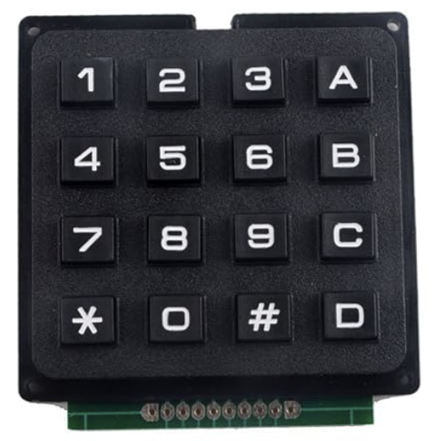
Keypad Selection
Type | Technology | Advantages | Disadvantages | Suitability for Safe Design
Membrane | Flexible layers of membranes that are connected | Easier to clean and maintain Resistant to dirt or water Slim profile and lightweight | Limited tactile feedback Less durability for frequent pushing | More suitable for compact design due to slim size Best for safes requiring minimal space or weight
Mechanical | Physical push buttons with tactile feedback | Stronger and withstanding Easy to interface with Debouncing feature | Heavier weight Prone to dust or water | Suitable for robust designs Good for safes requiring long-term durability and user feedback
Touch Sensor | Keys that senses physical human touch | Less likely to physical damage Cannot be damaged by dust or liquid Modern design | Sensitive touch factors Requires cleaning Fewer available products | Ideal for sleek, modern safes Lightweight and tech-forward option, though less common
For our keypad selection we chose the Membrane Keypad because it is user friendly, easy to maintain, and designed to take up minimal space and weight
Final Decision: NEXTION 16 Keys Matrix Keypad 4x4 Membrane Keyboard Module
Lakshmi (CpE)
Notes:
Speaker: Lakshmi

Slide 12
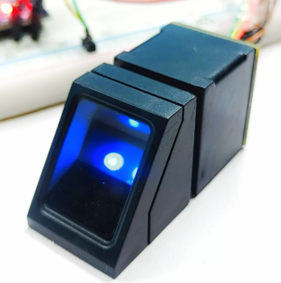
Fingerprint Sensor Selection
Type | Technology | Advantages | Disadvantages | Suitability for Safe Design
Capacitive | Uses pressure of the fingerprint | Difficult to replicate Fast speed High accuracy Robust | High cost Susceptible to electrostatic discharge damages Sensitive to wet or very dry fingertips | More suitable for compact design due to slim size Suitable for robust designs
Optical | Uses light of the fingerprint | Cost effective Fast speed Easy maintenance Easily available in the market Work well with variety of skin conditions | Susceptible to hacking Not as robust than others Sensitive to dry, oily, or wet fingertips | More suitable for variety of skin conditions like scars Easy integration Fast processing time
Thermal | Uses the heat pattern of the fingerprint | Difficult to replicate Functions effectively when fingertip is dry, oily, or wet Reliable | High cost Requires more maintenance than others Slow speed Sensitive to significant temperature changes in the environment | More suitable for designs with no size constrictions Suitable for varying fingertips in cleanliness, moisture or dryness levels
For our fingerprint scanner selection, we chose the optical fingerprint sensor because of its reliability, fast accuracy, and suitability for a variety of skin conditions like scars
Final Decision: Hangzhou Grow Tech’s GROW R307 Fingerprint Module
Alexis (EE)
Notes:
Speaker: Alexis

Slide 13
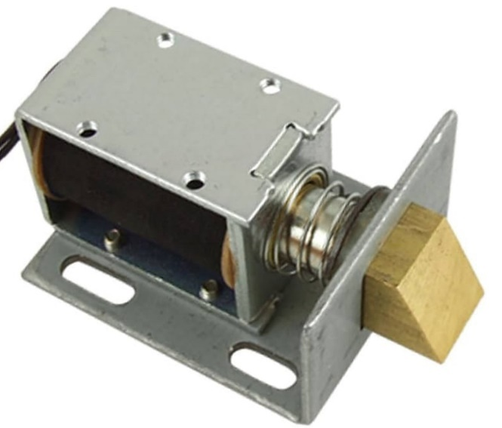
Lock Mechanism Selection
Type | Technology | Advantages | Disadvantages | Suitability for Safe Design
In-Linear Actuator | Converts rotational motion into linear motion using an AC or DC motor | Precise movement Robust Easy integration | Slow speed Complicated integration High levels of noise Expensive Heavy | More suitable for circuit due to precise movement Robust
Stepper Motor | Converts electricity pulses into rotation motion by a fixed number of degrees | Precise movement Cost effective | Chance of slipping Chance of missing steps High levels of noise Susceptible to overheating High current consumption Heavy | More suitable for circuit due to precise movement Cost effective
Solenoid | Converts electrical current into linear motion using electromagnetism | Low power consumption Reliable Fast speed Cost-effective Easy integrations | Limited stroke strength Susceptible to overheating High current consumption | More suitable for circuit due to light weight Low power consumption Cost effective
For our lock mechanism selection, we chose the solenoid due to its quicker response time and low power consumption while provding the same benefits as the other two
Final Decision: Uxcell’s 1240L-12E07
Alexis (EE)
Notes:
Speaker: Alexis
(includes relay)

Slide 14
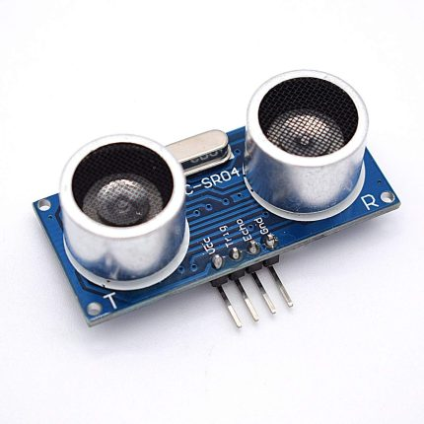
Motion Sensor Selection
Product | Voltage | Operating Current | Number of pins | Serial Communication | Cost
HC-SR04 | 5V | < 5mA | 4 | I2C | $2.00
URM37 V5 | 3.3-5V | 20mA | 9 | UART | $13.90
TCT-40 | 3.3V | N/A | 4 | I2C | $9.95
Nick (CpE)
Final Decision: HC-SR04
Notes:
Nick
(mention ultrasonic sensor)

Slide 15
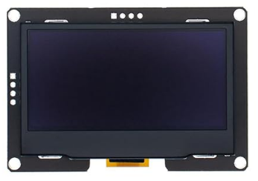
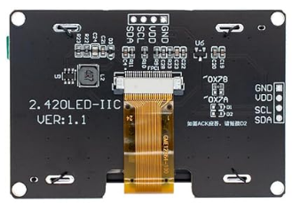
Display Selection
Product | Voltage | Display Size | Number of pins | Serial Communication | Cost
LCD 1602 Module | 5V | 2 inches | 4 | I2C | $2.00
ESP32 Touchscreen 2.8inch TFT LCD Display | 3.3-5V | 2.8 inches | 4/7 | SPI/UART | $20-$35
HiLetgo 2.42” SSD1309 | 3.3V | 2.42 inches | 4 | I2C | $9.95
Nick (CpE)
Final Decision: HiLetgo 2.42” SSD1309
Notes:
Nick
(change display to newer one if we decide to change)

Slide 16
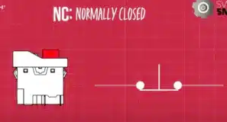
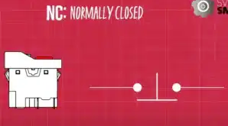
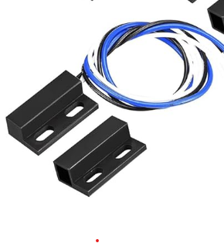
Magnetic door sensor
Product | Max Voltage | Max Current | Wire Length | Sensing Distance | Cost
Gebildet NO/NC Magnetic Switch | 100V | 0.5A | 30cm | 10mm – 20mm | $9.99
GAGALOR Heavy Duty Wired Alarm NC | 100V | 0.2A | 34cm | >=50mm | $15.99
VictorsHome Magnetic Reed Switch NC | 36V | 0.1A | 30cm | 10mm – 20mm | $8.99
Nick (CpE)
Final Decision: Gebildet NO/NC Magnetic Switch

Slide 17
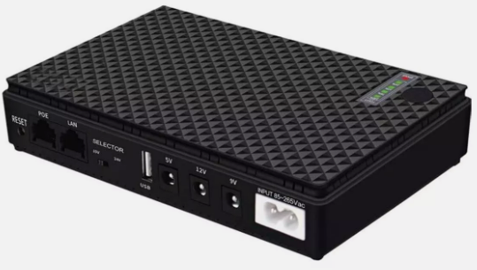
Battery Selection
Type | Technology | Advantages | Disadvantages | Suitability for Safe Design
Alkaline | Converts chemical energy into electrical energy through a chemical reaction | Stable voltage until depleted Light weight Cost-effective Easily available in the market | Short lifespan in storage and in use Lower energy capacity Temperature sensitive | More suitable for circuit due to light weight Easily available in the market
Lithium | Converts movement of lithium ions into electrical energy | Higher energy capacity Longer lifespan in storage and in use Wider temperature range Rechargeable option | Higher energy capacity Longer lifespan in storage and in use Wider temperature range Rechargeable option | More suitable for circuit due to longer lifespan in storage and in use Higher energy capacity
For our battery selection, we chose lithium batteries due to its higher energy capacity, longer lifespan both in storage or during use, and a wider temperature range compared to alkaline batteries
Final Decision: INVERCRIGIL Mini UPS Battery Backup
Alexis (EE)
Notes:
Alexis

Slide 18
Linear vs Switching regulators
Linear Regulators
Switching Regulators
Cheap & dependable
Low output voltage ripple & noise
High power dissipation
Simple in design(only need an input & output capacitor)
Expensive & versatile
Can act as buck/boost converters, have high noise
Low power dissipation
Complex in design
Eric(EE)
Final Decision: Linear Regulators

Slide 19
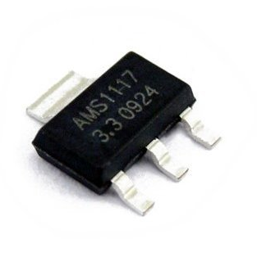
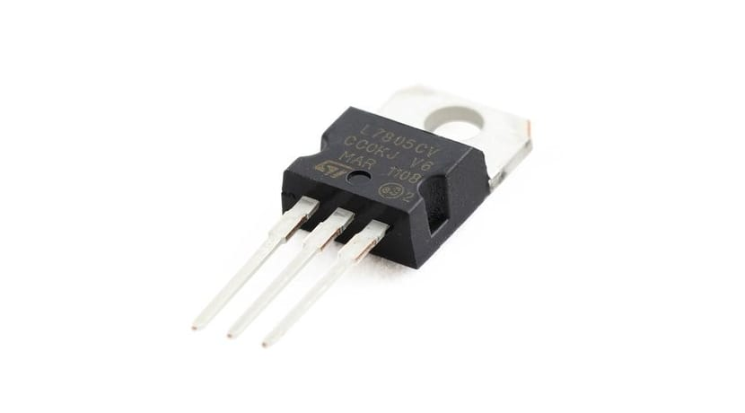
Voltage Regulator Selection
Product | Dropout Voltage | Output Voltage Acc. | Output Current | Max Input Voltage | Cost
LD1117V33 | 1.1V | +/-1% | 800mA | 15V | $0.60
HT7333​ | 90mV | +/-3% | 250mA | 12V | $0.65
AMS1117 | 1.2V | 1.5% | 1A | 18V | $0.58
LM7805 | 2V | +/-2% | 1.5A | 35V | $0.33
Eric(EE)
Final Decision: AMS1117 & LM7805
Notes:
Eric

Slide 20
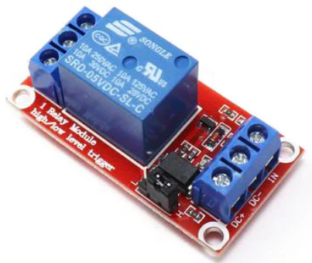
Relay Selection
Type | Technology | Advantages | Disadvantages | Suitability for Safe Design
Electromechanical | Uses electrical and mechanical mechanisms | Easy integration Good thermal management Separates power between two circuits High current and voltage ratings Easily available in the market Cost-effective | Slow speed Wear out over time because of mechanical mechanism Bulkier than solid state relays | More suitable for circuit due to power isolation between two circuits High current and voltage ratings Good thermal management Cost-effective
Solid State | Uses only electrical mechanisms | Fast speed Robust Compact | Expensive Limited voltage ratings Bad thermal management Can’t separate power between two circuits as well as electromechanical relays | More suitable for circuit due to longer lifespan in storage and in use Higher energy capacity
For our relay selection, we chose the electromechanical relays due to its high current and voltage ratings, thermal management, and popularity
Final Decision: Songle Relay’s SRD-05VDC-SL-C
Alexis (EE)
Notes:
Alexis

Slide 21
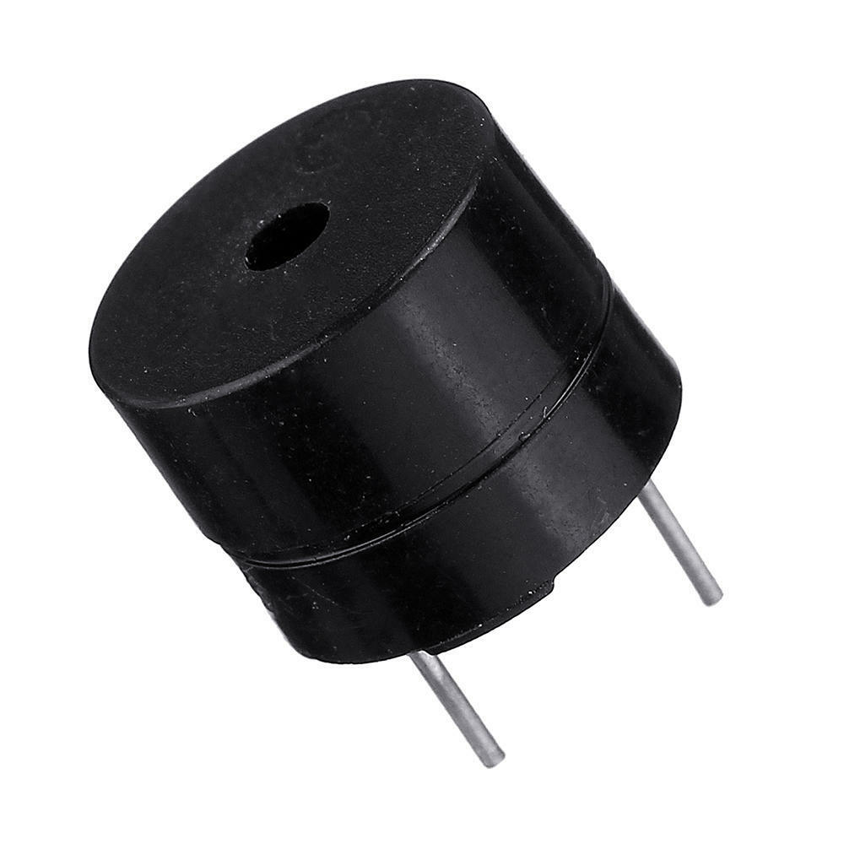
Buzzer Selection
Product | Frequency | Operating Voltage | Max current | Price
Electromagnetic Buzzer | 2.73kHz | 4-6V | 60mA | $1.49
Magnetic Buzzer | 2kHz | 2.54-4V | 25mA | $6.99(10 pk)
Piezo Buzzer | 2kHz | 4-8V | 15mA | $0.95
Eric(EE)
Final Decision: Magnetic Buzzer
Notes:
Eric

Slide 22
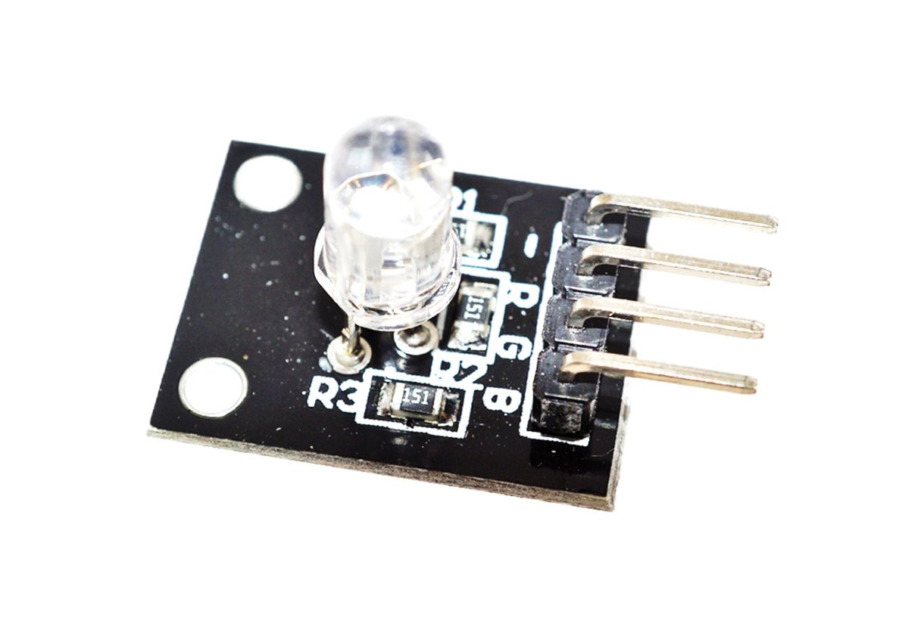
LED SELECTION
Product | Company | Forward Current | Price
Common Anode LED | Shenzhen Fedy Tech | 20mA | $2.00
RGB LED Module | DIYables | 20mA | $9.99(10 pack)
Common Cathode LED | CHANZON | 20mA | $8.99(100 pack)
Eric(EE)
Final Decision: RGB LED Module

Slide 23
Website Technology Selection
Technology | Purpose | Language
ESP32 WebServer (ESP-IDF or Arduino Core) | Performance and asynchronous processing | C++
ESP32AsyncWebServer | Simplicity | C++
MicroPython with uasyncio | Python Development | Python
We decided to go with the ESP32AsyncWebServer because of the many libraries that work with the ESP32 that make it easier to setup IoT dashboards and real-time applications. Since the website currently only asks for an email to input for the safe owner to receive notifications.
Nick (CpE)
Notes:
Nick ( mention async web server library) (mention what the website will be used for aka entering user’s email)

Slide 24
Email Protocol and Library Selection
Email Protocol | Purpose | Storage method | Use Case Suitability
SMTP | Sends Email from Client to Server | Not applicable; used only for sending | Sending outgoing emails; typically used by email servers and applications
POP3 | Receives emails from one client and downloads to local device | Emails stored locally on the device after download | Suitable for single-device email access with offline storage
IMAP | Receives emails from multiple clients and downloads them across devices. | Stored on the server with optional local caching | Ideal for multi-device access and constant synchronization
SMTP Protocol is the best protocol to use to send email notifications for our project. SMTP is easy to implement and can be used with any service provider.
We will be using the ESP-Mail Client Library which is designed specifically for the EPS32 microcontroller and used with the SMTP Protocol.
Lakshmi (CpE)
Notes:
Lakshmi
(maybe add a slide for software libraries if need be)

Slide 25
Email Service platform and provider selection
Email Platform | Purpose | Features | Email Sending Limit
Gmail | Widely used email platform | - Spam filtering - User-friendly interface - Advanced security features | 500 emails per day
Outlook | Business-oriented email platform | - Enhanced security - Business-specialized features - Spam protection | 300 emails per day
Yahoo | Established global email service platform | - Spam filtering - Basic encryption - Easy navigation | 100 emails per day
We will use Gmail SMTP Service Provider because it works well with the Gmail Service Platform and provides efficient email delivery
We chose Gmail as our email service platform for users to receive email notifications regarding their safe. Gmail is a user-friendly and reliable email service. It comes with enhanced security protocols like TLS and email authentication
Lakshmi (CpE)
Notes:
Lakshmi – mention security protocols, fast email delivery

Slide 26
Software and Hardware program selection
Software | Ease of Use | Real-Time testing | Designed For | Debugging Capabilites
Visual Studio Code | High | No | General Purpose, Programming IDE | Limited
Code Composer Studio | Moderate | Yes | Programming TI microcontrollers | High
Platform IO | Moderate | Yes | Embedded Development | High
Arduino IDE | High | Yes | Embedded Development, microcontroller programming | High
Hardware | Ease of Use | Designed for
Eagle PCB | Moderate | Used to create and design PCB schematics
KiCad | Moderate | Used to design and create PCB schematics with advanced features
Fusion 360 | High | 3D modeling software used to design and create hardware components
Final Decision: Fusion 360
Final Decision: Arduino IDE
Lakshmi (CpE)

Slide 27
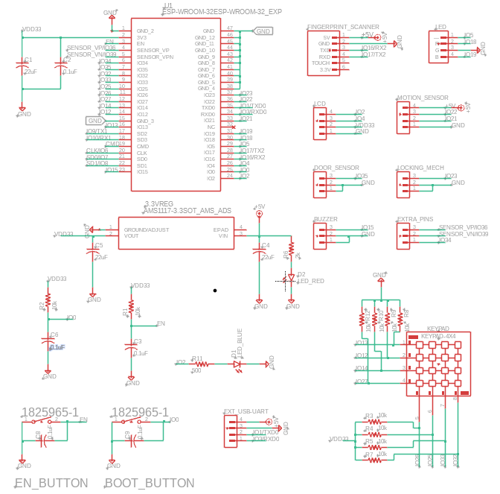
PCB Design
PCB #1: Main PCB
This board has our ESP-WROOM-32 MCU that is responsible for powering & communicating with our peripherals for the safe
Has a GPIO pin reserved for the operation of our locking mechanism PCB
Eric(EE)
Notes:
Eric/Alexis

Slide 28
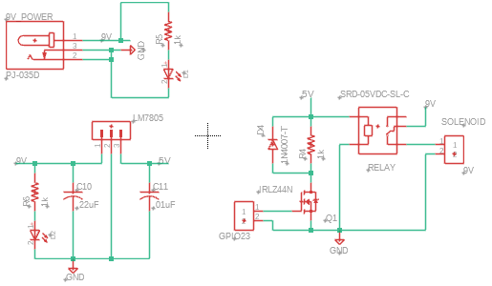
PCB Design(CONT.)
PCB #2: Locking Mechanism
This board contains our safe's entire locking mechanism circuit
The relay controls the locking/unlocking mechanism
The transistor also allows the ESP32 to control the relay indirectly by using a GPIO pin from our main PCB
The transistor also isolates the ESP32 from the relay’s inductive load
Alexis (EE)
Notes:
Eric/Alexis

Slide 29
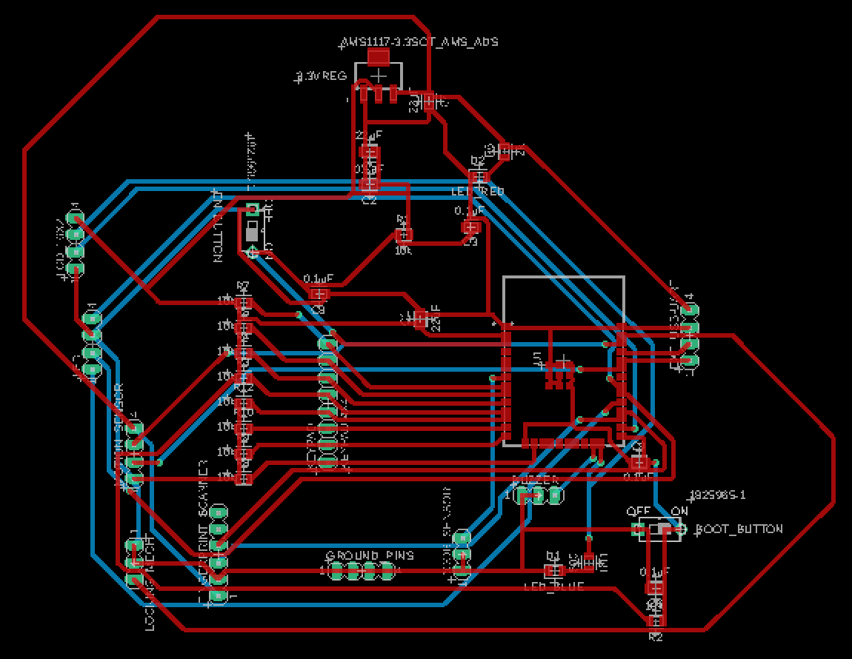
PCB Layout
Main PCB
ESP-WROOM-32
3.3V Regulator
Keypad
Fingerprint Scanner
RGB LED
Buzzer
Motion Sensor
Display
Door Sensor
Ext. USB-UART Converter
Eric(EE)
Notes:
Eric/Alexis

Slide 30
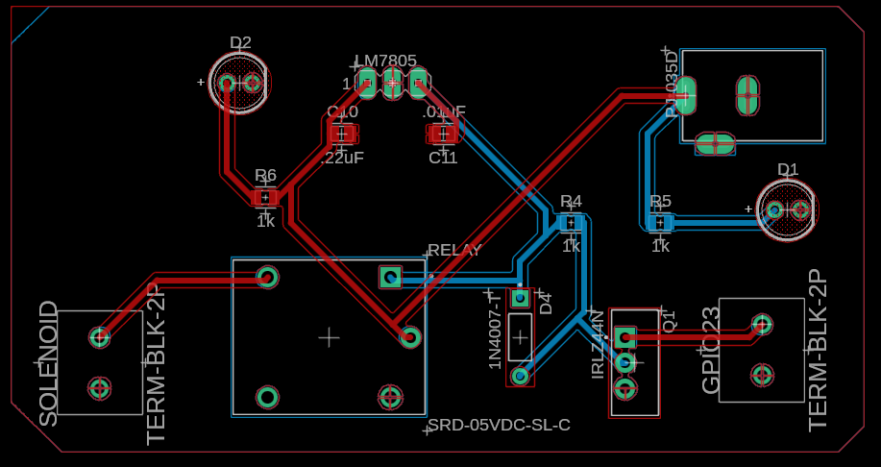
PCB Layout
Locking Mechanism PCB
5V Voltage Regulator
Power Barrel Jack
SPDT Relay
N-Channel MOSFET Transistor
Solenoid
Alexis (EE)
Notes:
Eric/Alexis

Slide 31
Hardware Testing
Component | Testing Method | Success/Failure | Comments
ESP-WROOM-32 | Blink the LED while printing to the serial monitor every second | Success | None
Keypad | Print any key that is pressed to the serial monitor | Success | The first four pins are the column pins while the next four pins are the row pins
Fingerprint Scanner | Enrolling a new fingerprint, scan a fingerprint to see if there is a match | Success | Flashes a blue light to indicate readiness
Locking Mechanism | Built the circuit on a breadboard in the SD lab | Success | Used the power source in lab to power the lock
Ultrasonic Sensor | Measure the distance of an object in front of it | Success | None
Buzzer | Have the buzzer make a noise for one second and go silent for four seconds | Success | We can increase and decrease the sound of the buzzer
RGB LED | Have the LED change colors every second(red, green, blue, purple, white) | Success | The LED channel labels for red & blue & green & GND were switched
Display | Having it display "Welcome to Smart Safe" | Success | None
Eric(EE)
Notes:
Eric/Alexis

Slide 32
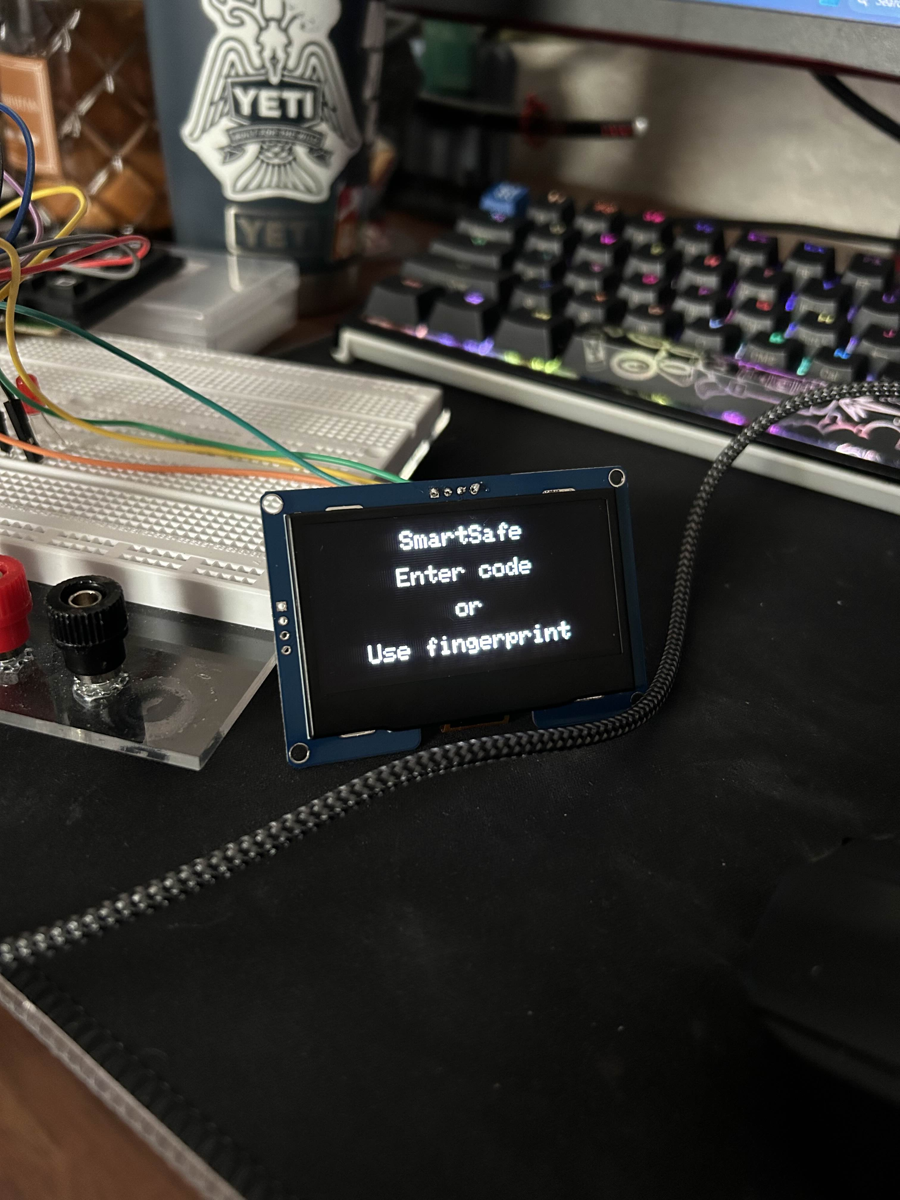
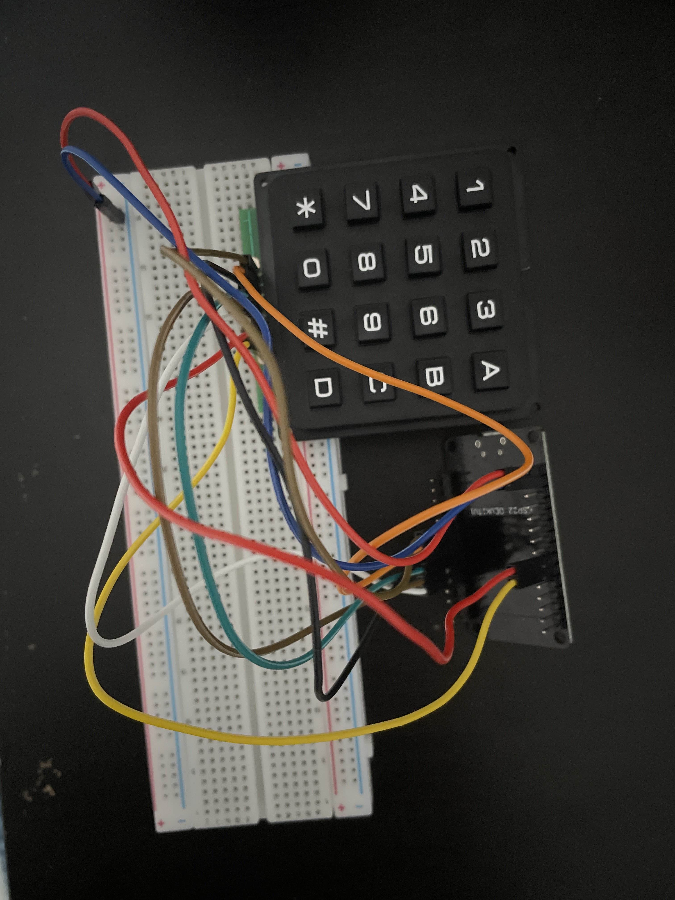
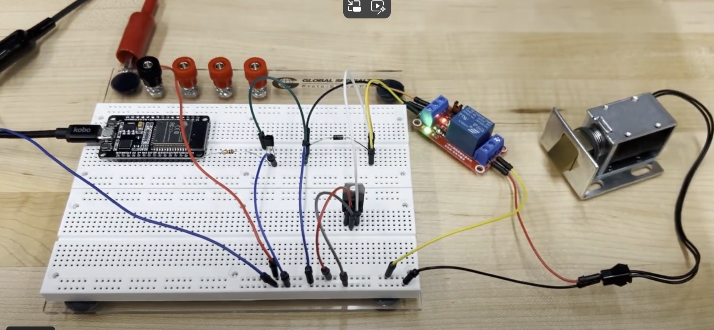
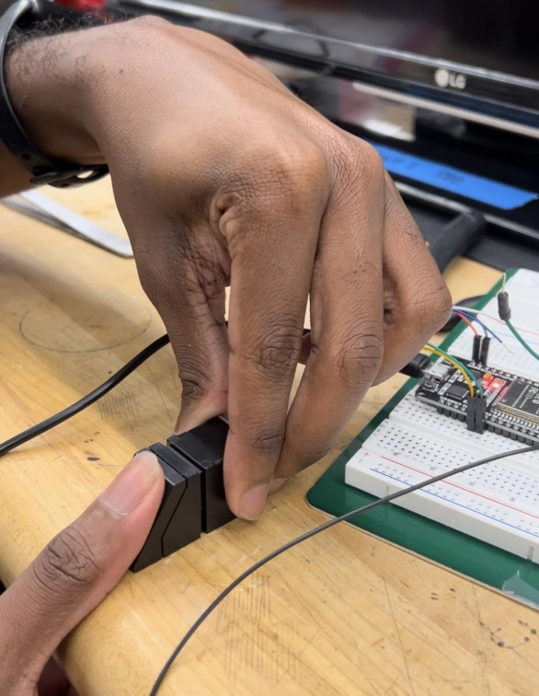
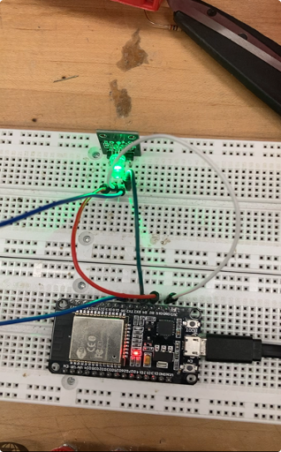
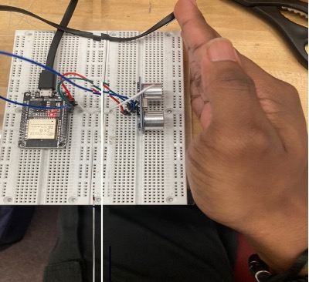
Hardware Testing
Eric(EE)
Notes:
Eric/Alexis
Door sensor + while thing + buzzer

Slide 33
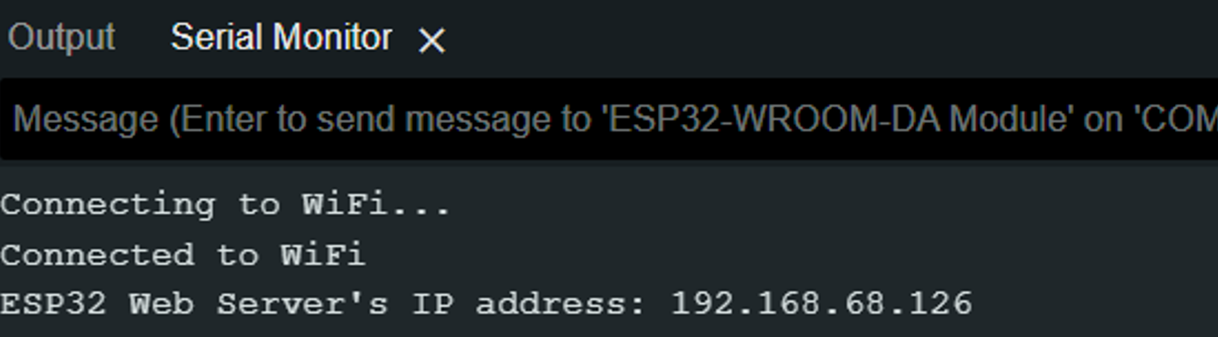
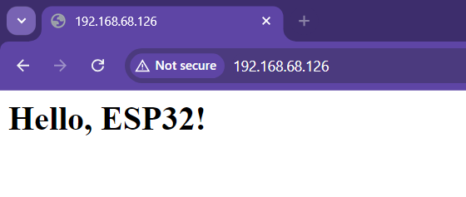
SOFTWARE TESTING - website
Lakshmi (CpE)
We will host a local server directly using the ESP32 MCU. After connecting to a local Wi-Fi network, the ESP32 will provide a local IP address where we can access the website. We will setup a route to serve the HTML Page and use HTML and JavaScript to design it.
Screenshot from Arduino IDE showing the web server request and connection to Wi-Fi
Screenshot of the IP address from the requested web server showing the test message
Notes:
Lakshmi

Slide 34
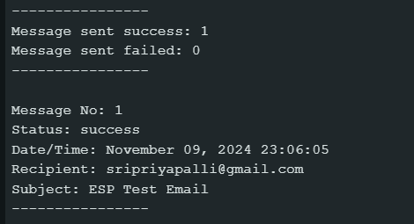
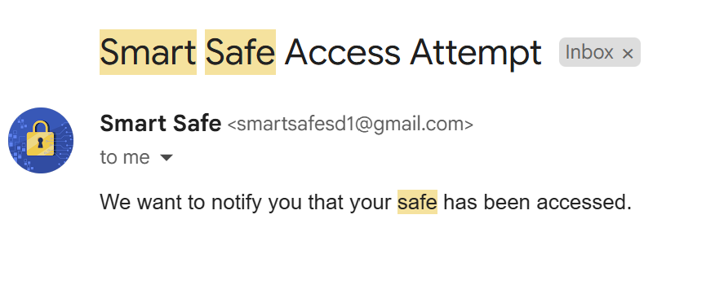

SOFTWARE TESTING - EMAIL NOTIFICATIONS
We will set up email functionality using the Gmail SMTP protocol and authentication credentials. The safe user will receive emails from a special Gmail account created for this project: smartsafesd1@gmail.com.
Lakshmi (CpE)
Screenshot showing that the email has been sent successfully to the expected recipient in Arduino IDE
Screenshot of an email being sent from the smart safe Gmail account to the Recipient’s Gmail inbox informing them about a safe access attempt

Slide 35
Work DISTRIBUTION
Lakshmi (CpE)
Team Member | Main PCB Development | Lock PCB Development | Software Code | Component Testing
Primary | Eric | Alexis | Lakshmi | Nick
Secondary | Alexis | Eric | Nick | Lakshmi
Eric | Alexis | Lakshmi | Nick
Design/Create Main PCB PCB Soldering Safe Design Component Testing | Design/Create Lock PCB PCB Soldering Safe Design Lock and Relay Testing | Implementing Email Notifications and Web Server Writing Software Code Component Testing Task Management | Implementing Motion/ Door Sensor Design Display UI Safe Design Component Testing

Slide 36
Budget and Bill of Materials
Item | Quantity | Estimated Cost | Total Cost
MCU | 1 | $20 | $15.99
Display | 1 | $18 | $16.99
Keypad | 1 | $3 | $5.95
Fingerprint Sensor | 1 | $24 | $24.27
Ultrasonic Sensor | 1 | $6 | $6.99
Magnetic Sensor | 1 | $10 | $9.99
Solenoid Lock | 1 | $13 | $14.99
LED | 1 | $0.30 | $9.99
Buzzer | 1 | $6 | $7.99
Voltage Regulator | 1 | $5 | $8.19
Relay | 1 | $3 | $7.39
DC Power Connector | 1 | $4 | $5.99
Power Source | 1 | $50 | $59.99
TTL Converter | 1 | $10 | $7.39
Sheet Metal | 6 | $20 | $0
Hinges | 2 | $4 | $7.99
Handle | 1 | $15 | $12.99
PCBs (with shipping) | 10 | $80 | $125.02
Total |  | $291.30 | $348.10
Alexis (EE)
Notes:
Alexis – If too short bring up fingerprint sensor

Slide 37
Hardware Challenges
The stencil that came with the main PCB was too big, however we managed to work around it and spread the solder paste on the PCB for the SMD components
Kept getting an error message every time I would try to upload code using the external USB-UART converter until I figured out how to put the ESP-WROOM-32 into upload mode
Had to unsolder a couple of the header pins due to solder being stuck in between the holes
The lock would automatically unlock by itself without having to put in a password
The power traces for the motion sensor & fingerprint scanner were disconnected to the +5V power trace, so we had to solder a wire so that the motion sensor & fingerprint scanner could receive power
Eric(EE)
Notes:
Fingperint sensor
Testing pcb is tricky and hard
Figuring out safe design….
Pcb is expensive :(

Slide 38
Software Challenges
The ESP32 can only connect to a local 2.5 GHz band Wi-Fi network and does not work with local UCF Wi-fi
The user will have to wait until an email notification has finished sending from the ESP32 in order to use the safe
Implementing the email and web server caused a memory issue with the ESP32 which required the special use of a partition scheme to allocate more memory to the application
We needed a solution to automatically store user’s email addresses from the website into the ESP32. We accomplished this by using EEPROM memory
Lakshmi (CpE)
Notes:
Lot of the components needed a lot of debugging and testing
Fingperint scanner gave issues with enrolling finger
Figuring out how to not allow the motion sensor to constnalty detect motion
How to saw email address in memory so user doesn’t have to constantly retype it and it will be saved in memory
Website only works when your connected to the same wifi network…

Slide 39
Progress & Plan
Task | Start Date | End Date | Duration
Finalizing PCB Design | 1/6 | 1/16 | 10 days
PCB Ordering | 1/17 | 1/22 | 5 days
PCB Assembly | 1/22 | 1/30 | 8 days
PCB Testing | In Progress | TBD | TBD
System Integration/Testing | In Progress | TBD | TBD
CDR Preparation | 1/25 | 2/19 | 3.5 weeks
Midterm Demo Preparation | 2/19 | 3/8 | 2.5 weeks
8-Page Conference Paper | 3/10 | 3/17 | 1 week
Final Project Review Preparation | 3/10 | 4/12 | 1 month
Finalize Documentation | 4/14 | 4/22 | 8 days
Practice Final Presentation | TBD | TBD | TBD
Final Presentation | TBD | TBD | TBD
Alexis (EE)
Notes:
Alexis
(maybe a bullet points list or a timeline instead of a table)

